Slide 1


GENOM-POF: Multi-Objective Evolutionary Synthesis of Analog ICs with Corners Validation
9th Annual “HUMIES” Awards for Human-Competitive Results
Genetic and Evolutionary Computation Conference (GECCO), 2012
Nuno Lourenço, Nuno Horta
IT / Instituto Superior Técnico, Lisboa, Portugal

Slide 2
OUTLINE
A short introduction to the published result
  N. Lourenço, N. Horta, “GENOM-POF: Multi-Objective Evolutionary Synthesis of Analog ICs with Corners Validation”, Genetic and Evolutionary Computation Conference (GECCO) 2012, July 2012, Philadelphia, USA
Why our result is “Human-Competitive”
Why our result is the “best” entry

Slide 3


Slide 4
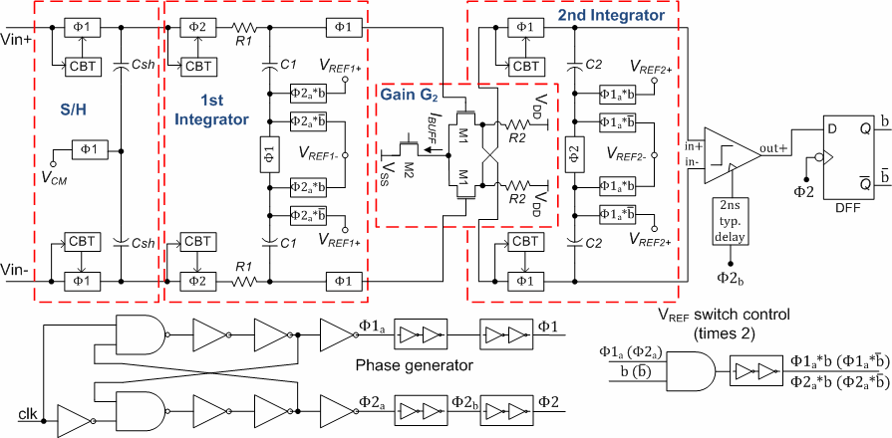
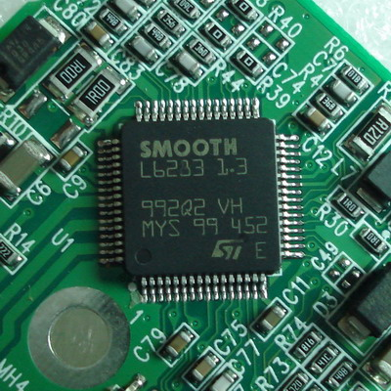
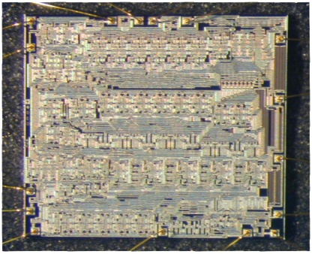
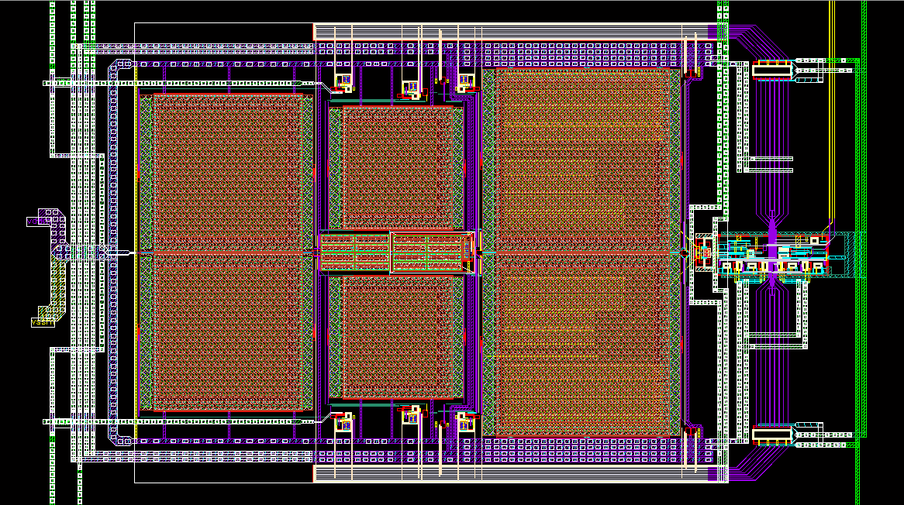
Analog Integrated Circuit
Digital
Analog
Digital
Low Power ΔΣ- Modulator
[J. Goes, UNINOVA/CTS, 2011]

Slide 5
Why Analog IC Design Automation?
Unlike digital circuits, in analog integrated circuits, even the low level phases of the design are hand-made.
The lack of automation makes the design:
Difficult to Reuse
Long
Error Prone
Analog IC are very sensitive to technology variations
Analog IC are being integrated using technologies optimized for digital circuits
Low Power ΔΣ- Modulator
[J. Goes, UNINOVA/CTS, 2011]

Slide 6
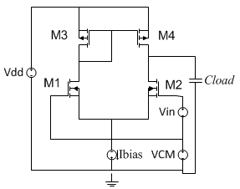
GENOM-POF: Multi-Objective Evolutionary Synthesis of Robust Analog ICs
Features:
  Modified NSGA-II Optimization Kernel.
  Evaluation using industrial grade electrical simulation.
  Accounts for Process and Environmental variations through the inclusion of corner validation.
GENOM POF

Slide 7
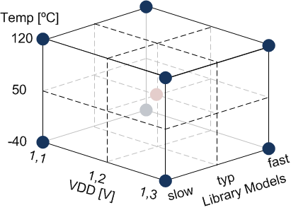
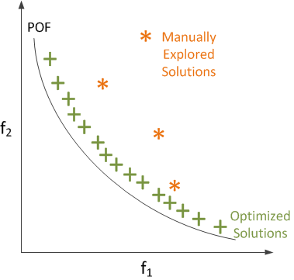
Why our result is “Human-Competitive”
(D) The result is publishable in its own right as a new scientific result — independent of the fact that the result was mechanically created.
  the presented approach is NEW in literature.
  implements MULTI-OBJECTIVE / MULTI-CONSTRAINED circuit synthesis.
  Includes EXTREME technological and environmental variations.
  Results are OPTIMAL and ROBUST.

Slide 8
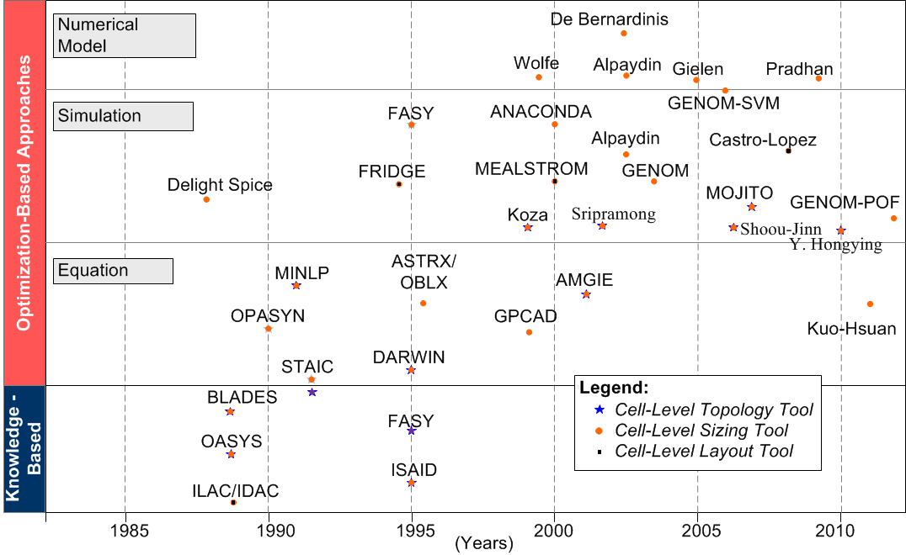
Why our result is “Human-Competitive”
(E) The result is equal to or better than the most recent human-created solution to a long-standing problem.
  Industrial grade electrical simulator guarantees ACCURACY.
  Corner validation handles INDUSTRY requirements for robustness

Slide 9
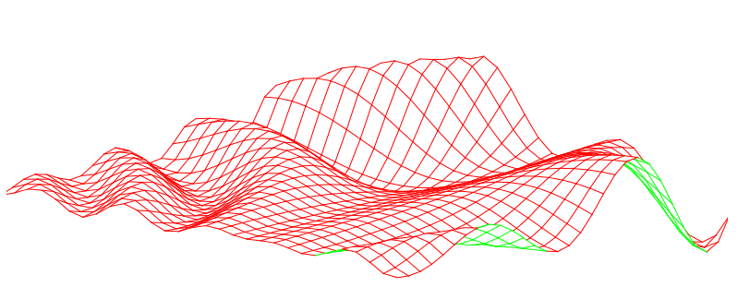

Why our result is “Human-Competitive”
(G) The result solves a problem of indisputable difficulty in its field.
  The problem of sizing analog integrated circuits is extremely complex, specially, when trying to OPTIMIZE PERFORMANCE and MINIMIZE COSTS.
  few objectives, dozens of real variables, and dozens of real constraints, lead to HUGE NON-LINEAR decision and objective spaces
  The results are synthetized in MINUTES where the designer can take HOURS

Slide 10
Why our result is the “best” entry
We solve real problems of a $300 billion industry.
The approach deals with a problem of indisputable difficulty, that is still solved manually by designers in the industry, in a time consuming and error-prone process.
No other design automation tool are implementing such a restrictive and realistic design approach – multi-objective with extreme technological and environmental variations together with a high accuracy evaluation engine.
Solving this no trivial industry problem automatically using multi- objective evolutionary strategy leads to a 5-10X reduction in terms of design time.
Notes:
The approach solves a problem of indisputable difficulty for the integrated circuits industry and considering the most challenging technologies.
The approach beats state-of-the-art analog IC design automation solutions from both academia and industry (commercial tools), once, from the best of our knowledge, no other design automation tool are implementing such a restrictive and realistic design approach – multi-objective with extreme technological and environmental variations together with a high accuracy evaluation engine.
(3) The achieved optimally sized solutions beat humans in terms of performance and design time. Solving this no trivial industry problem automatically using multi- objective evolutionary strategy leads to a 5-10X reduction in terms of design time (even if the setup time is included).

Slide 11
THANK YOU!!!

