Slide 1
Evolving Chua’s Circuit Topology Using Genetic Algorithm
7th Annual “HUMIES” Awards
Adam Rak, Gaurav Gandhi and Gyorgy Cserey
July 2010

Slide 2
Related Publications
A. Rák, G. Gandhi, and Gy. Cserey, "Chua's Circuit Topology Evolution Using Genetic Algorithm”, International Journal of Bifurcation and Chaos, Volume 20, Issue 3, pp. 687-696.
Notes:
The HUMIES entry is based on this publication which was also a part of Ph.D thesis of second author. A comparison was also made with human intuitive way of designing as the second author has also published as well as patented Chua’s circuit designs (details later).

Slide 3
The Problem
Chaotic System
Chua’s Circuit
Electronic Realization of Chua’s circuit
Issues
Prior Human Attempts
Notes:
Analog circuit designing follows the approach of "Linearize and Analyze" which isn't true in the realms of non-linear system design. Chaotic systems work in non-linear and chaotic regime, a state where the dynamical system is highly sensitive to initial conditions, making them much harder to design and humanly comprehend. This makes the problem of designing chaotic circuits as a whole an even more complex problem than that of analog design.
In circuit theory, Chua's circuit, invented by Prof. Leon Chua in 1983, has been described as a paradigm for chaos. With applications ranging from cryptography to chaotic music, Chua's circuit has attracted the attention of circuit designers as well.
However, since its inception 27 years ago, there are only around 20 different implementations of Chua's circuit reported in the literature. Most of these designs have similar topologies because Chua's diode, a key element of Chua's circuit, is nonlinear and does not have a set recipe to design.
Till now all the Chua's circuits reported so far were made by humans and no one thought of automating the task by a machine. One reason for this can be that in order to evolve chaotic, a rigorous analysis of its time series is required and the lack of necessary and sufficient condition for a system to exhibit chaos might have stopped researchers to attempt the same. Thus designing a novel topology for a chaotic circuit, including a highly studied Chua's circuit (http://www.eecs.berkeley.edu/~chua/circuitrefs.html) is a very difficult problem for humans.

Slide 4
The Bigger Problem: Mindset
Thinking the non-linear way
Analog Circuit design
Nano-Electronics
Chaotic Systems
Emerging technologies
→ Computer Automation / Genetic Approach far exceeds Human Intuition when approach is of non-linear (“unconventional”) thinking.
Notes:
Authors feel that the bigger problem lies with the mindset of designing circuits. Linear circuit theory and linear way of thinking has dominated the education curriculum and our neurons are trained to solve linear problems efficiently. Anything nonlinear at times seems like “out of the box” approach to solve a given problem.
This is the main reason that the authors attribute to difficulty in designing circuits which shows behavior different from the linear approach. This can be the reason why analog circuit designing is considered as an art, as the people skilled in the art are the ones who have developed, with advent of time, an approach to think in non-linear way.
Circuit designers and scientists are finding it difficult to design “analog” circuits using emerging nano-electronic devices. The reason that is attributed is that these emerging devices have nonlinear characteristics unlike that of MOS, which humans have mastered for decades. This is one more reason why we rarely see any analog circuit being designed using these technologies.
A system exhibiting chaotic behavior is supposed to have at least one device with nonlinear V-I characteristics. Thus designing a chaotic system will require an approach to understand design of nonlinear block along with the entire system.
Authors strongly feel that for problems like these, the GA approach will be more suited than those of human intuitive ways of designing. Authors believe that the recipe of designing is known to humans but since the space for search is so vast, it is best given to software to search for the most optimized solution.

Slide 5
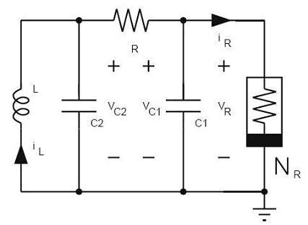
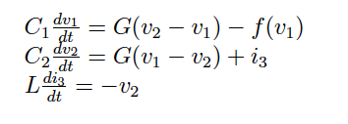
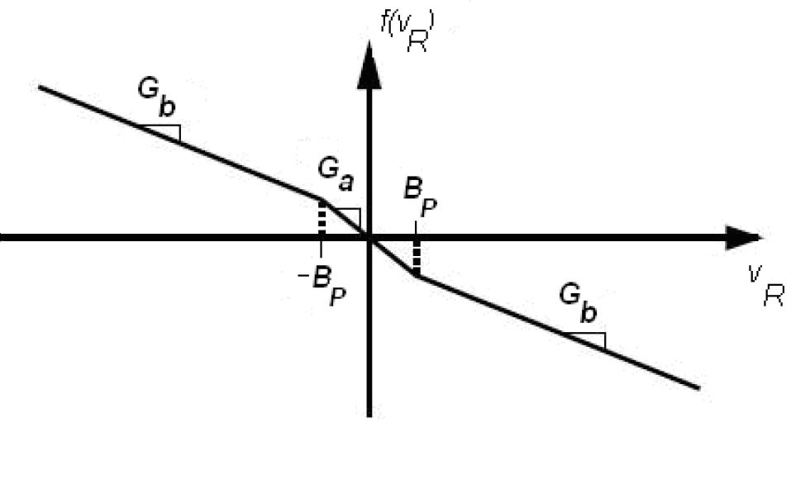
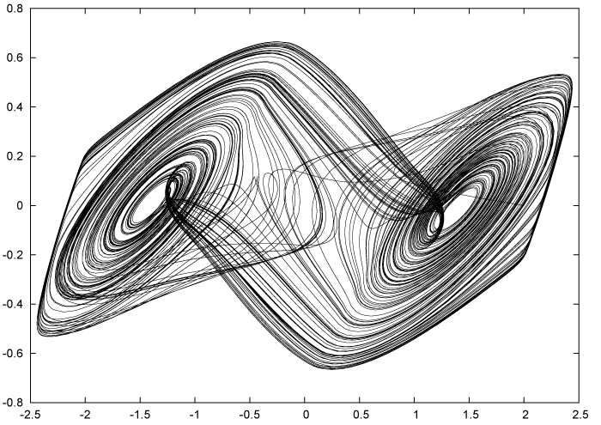
Chua’s Circuit Evolution: A Case Study
Notes:
A (Top Left) – Chua’s Circuit Diagram
B (Top Right) – V-I characteristics of Chua’s diode. f(v).
C (Bottom) – Voltage across two capacitors. This curve is famously known as Double Scroll. Chua’s circuit is highly sensitive to initial conditions.

Slide 6
GA Based Approach
Generation
Selection
Crossover
Mutation
Evaluation
Cost Function
Notes:
In our work SPICE based software that uses Genetic Algorithm (GA) has been used to invent a series of Chua's circuit topologies. It is the largest family of different Chua's circuit designed using discrete passive and active elements.
Almost all the invented designs were unique and were topologically patentable. These topologies are findings of evolutionary algorithm and some of them are not even anticipated by human intuitive thinking. All the evolved designs were simulated on SPICE and their results were found to be in agreement with the theory. Some of them were even bread boarded and results of chaotic simulations were seen on Oscilloscope, thereby proving the validity of evolutionary approach to Chua's circuit designing.
A simulation based approach to evolve Chua's circuit is used and SPICE is used to perform circuit simulations. The input to simulations is called individual, which contains the elements and their connection
---- Generation --
---- Selection
---- Crossover
---- Mutation
---- Evaluation
---- Cost Function :
Further in comparison to human ways of thinking which at times takes days to implement, the presented algorithm has evolved more than a dozen novel topologies for Chua's circuit in less than 24 hours on a single (Intel Xeon Hyper Thread, 3.4 GHz, 2 GB RAM) machine.
The current work is a perfect example of how evolutionary machine approach can aid human designers in designing systems limited by their intuitive ways of thinking.

Slide 7
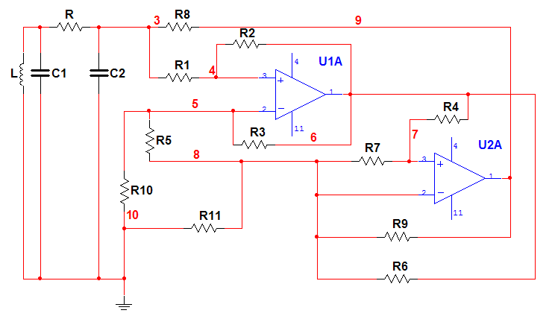
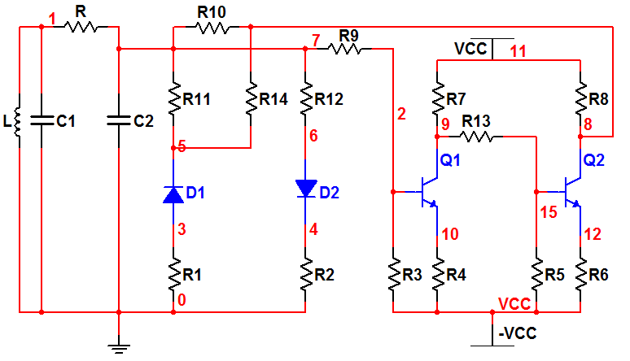
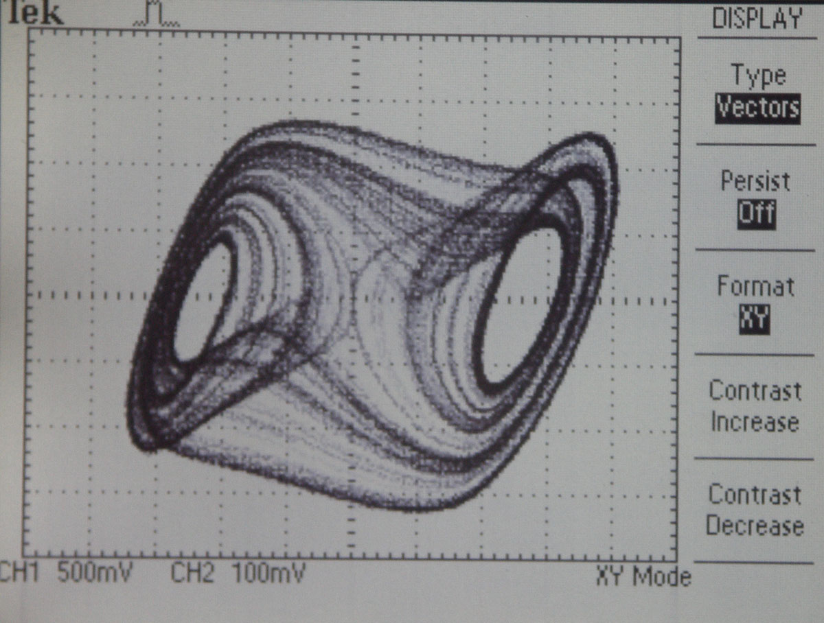
Results
Two of various evolved Architecture
Lab Results

Slide 8
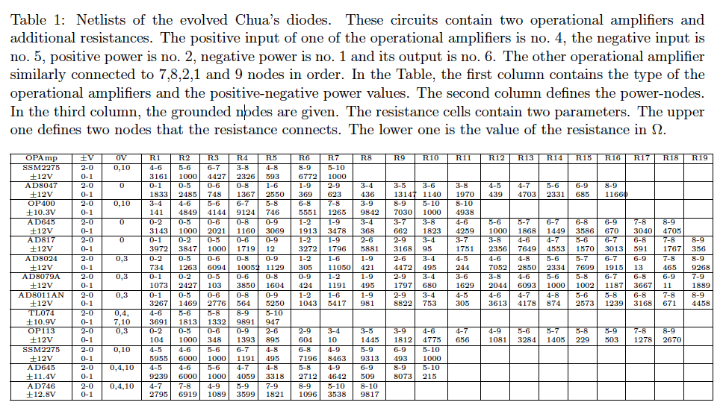
Results (contd..)

Slide 9
Future possibilities
“ This case/software is not limited to Chua's circuit but can be extended to evolve different case studies of nonlinear circuits with given DC characteristics”
GECCO HUMIES 2006 GOLD Winner
Memristor and CMOL based circuit designs
Designs employing Emerging nano-electronic devices like Single Electron Transistors, Carbon Nanotubes etc.
Notes:
Interestingly, the current work can be easily clubbed with the following mentioned work (which incidentally won HUMIES - 2006) to evolve a whole new set of patentable novel topologies of Chua's circuit
V. Aggarwal, "Evolving Sinusoidal Oscillators Using Genetic Algorithms", in Proc., The 2003 NASA/DoD Conference on Evolvable Hardware, Chicago, USA, 2003, pp. 67-76.
Another direction for future work can be in the field of nonlinear analog circuits using emerging devices including memristors, which are difficult to achieve using human way of thinking.

Slide 10
Memristor: An Example of Human Limitation
Memristor
Leon Chua’s Prediction of fourth element (1971)
HP’s invention of memristor (2008)
Circuit design using memristor
Digital Logic
No Analog circuits utilizing the smooth V-I curve
The presented approach is suitable for utilizing memristor/CMOL based circuits.
Notes:
Memristor, along with resistor, capacitor and inductor, were proposed by Prof. Leon Chua (Also inventor of Chua’s Circuit) in his seminal paper in 1971. However it was not until recently in 2008 that HP has demonstrated that such a device can exist. The interesting thing is that researchers have observed the “memristive” phenomenon in several devices in past but were not able to satisfactorily explain the same.
Several circuits are now being designed using memristors but most of them are primarily using the digital behavior of the device as it is easier to understand the switching behavior of the device. However in order to design an analog circuit using memristor, a deep understanding of it’s nonlinear curve will be required and new design philosophies to implement analog designs using memristor will be required.
Till we, as humans, develop such understanding, authors feel that GA based approach to circuit design using memristor will be the only way approach.

Slide 11
Criteria that the entry satisfies
(A) The result was patented, as an invention in the past, is an improvement over a patented invention, or would qualify today as a patentable new invention.
(B) The result is equal to or better than a result that was accepted as a new scientific result at the time when it was published in a peer-reviewed scientific journal.
(D) The result is publishable in its own right as a new scientific result independent of the fact that the result was mechanically created.
(E) The result is equal to or better than the most recent human-created solution to a long-standing problem for which there has been a succession of increasingly better human-created solutions.
(F) The result is equal to or better than a result that was considered an achievement in its field at the time it was first discovered.
Notes:
A -- The significance of the results is evident by the fact that a topology of Chua's circuit using human intuitive way of thinking has been patented in the past by one of the authors (refer US Patent No. 7119640). In present case all the evolved topologies were novel and some of them are like improvement on the patented design and are themselves patentable.
B -- The significance of the result is evident by the fact that invention of different Chua's circuits with the features mentioned has been published in International Journal of Bifurcation and Chaos.
D -- This paper has been accepted in International Journal of Bifurcation and Chaos, which is not concerned with the method of synthesizing chaotic circuits, but for its value in enhancing the state-of-art in chaotic systems and circuit designs.
E -- Chaotic circuit design is one of the hardest problems in circuit design and requires a complete different mindset. Chua's circuit, considered as a paradigm of chaos, has attracted circuit designers in recent past. However the limitations of human intuitive ways of thinking lead to almost similar circuit topologies for designed Chua's circuit.
Invention of several Chua's circuits using evolutionary algorithm is a significant leap in the field. There is no other larger catalogue of topologically patentable Chua's circuit designs using evolutionary approach. The development of some of these designs on breadboard and observing the behavior on oscilloscope proves the validity of evolved designs.
F -- Evident in the points mentioned above.

Slide 12
Why we should win the prize
The entry solves the problem of Chua's circuit design, which was considered an art by designers and has never been automated. It makes a first attempt to automate the task and is able to evolve several novel Chua's circuit designs using different discrete active and passive blocks in few hours. Note that the literature has reported an equal number of novel designs topologies of Chua's circuit in last two decades as what has been achieved in few hours using automation.
All the inventions are completely new, state-of-art and are topologically patentable.
Rigorous simulations and practical design in the lab back the results, thereby making them useful for both academic study as well as industrial use.
Many of these designs are interpretable and comprehensible and yet do not follow the set approach described in literature to design Chua's diode. This makes the present entry as a perfect case of how evolutionary machine approach can aid circuit designers in designing systems limited by their intuitive ways of thinking.

Slide 13
..contd
It opens possibilities of designing efficient nano scale circuits, a domain where human thinking usually defy the observations.

Slide 14
Acknowledgement
Prof. Tamas Roska
Varun Aggarwal

