Slide 1


Solving Iterated Functions Using Genetic Programming
f(f(x))
Michael Schmidt
Hod Lipson
2010 HUMIES Competition

Slide 2
Iterated Functions
Iterated Function:
Answer:
f(f(x)) = x
f(x) = x
f(f(x)) = x + 2
f(x) = x + 1
f(f(x)) = x⁴
f(x) = x²
f(f(x)) = (x² + 1)² +1
f(x) = x² + 1
f(f(x)) = x² – 2
f(x) = ?
Why is this problem so hard for humans?

Slide 3
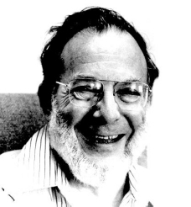


Test of Intelligence:
f(f(x)) = x² – 2
This problem has become famous in math and physics circles for requiring deep mathematical insight in order to solve.
"Mathvn journal problems," in Mathvn. vol. 01/2009 mathvn.org, 2009.
B. A. Brown, A. R. Brown, and M. F. Shlesinger, "Solutions of Doubly and Higher Order Iterated Equations," Journal of Statistical Physics, vol. 110, pp. 1087-1097, 2003.
Appeared in mathematical competitions
The rumored fastest solver Michael Fisher

Slide 4
The known solution requires deep human insight to solve a special case
Assume f(f(x)) = g(a²g⁻¹(x)):
g(a²g⁻¹(x)) = x² – 2
Next assume a² = 2 and let θ = g⁻¹(x) :
g(2θ) = x² – 2,
g(2θ) = g(θ)² – 2,
x² – 2 = g(θ)² – 2
By inspection:
x = g(θ) = 2 cos(θ),
x = g(g⁻¹(θ)) = 2 cos(g⁻¹(θ))
Double angle formula:

Slide 5
But there are possibly many solutions
f(f(x)) = x
f(x) = x
f(x) = –x
f(x) = 1/x
This a dark area of mathematics; Only a few special cases of functional problems have ever been solved.
Yet, Genetic Programming can find these solutions easily….

Slide 6
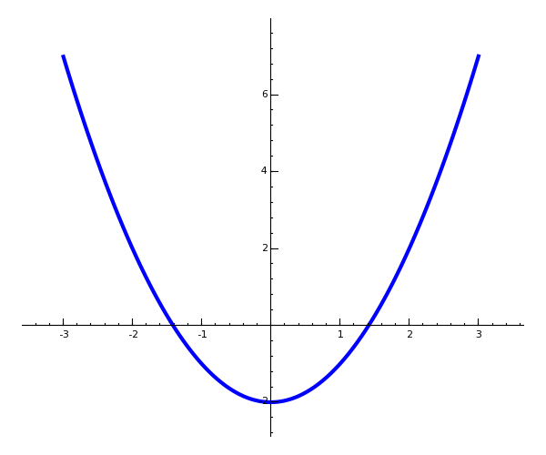
f(f(x)) = x² – 2
Straightforward application of Symbolic Regression
Fitness of a candidate f(x) =
Solutions iterated twice:
x² – 2
What is f(x)?
f(f(x))
x

Slide 7
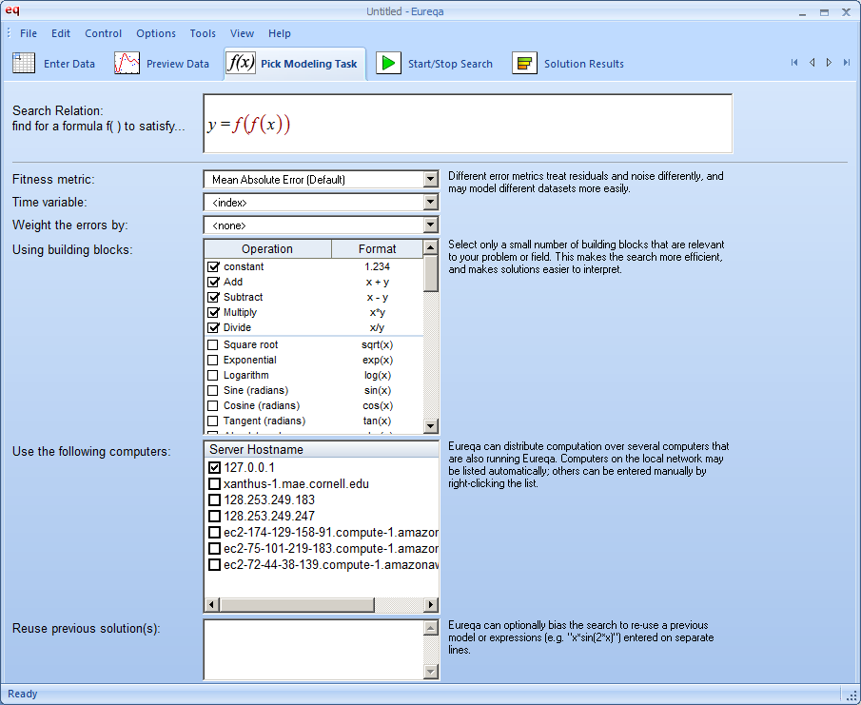
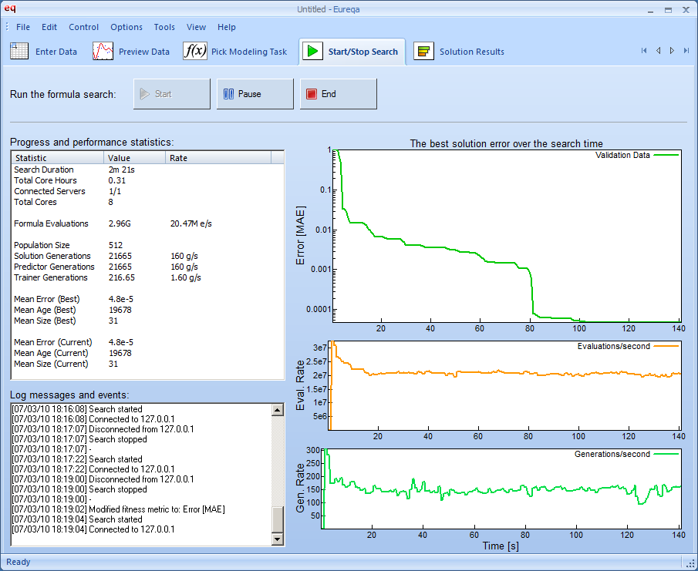
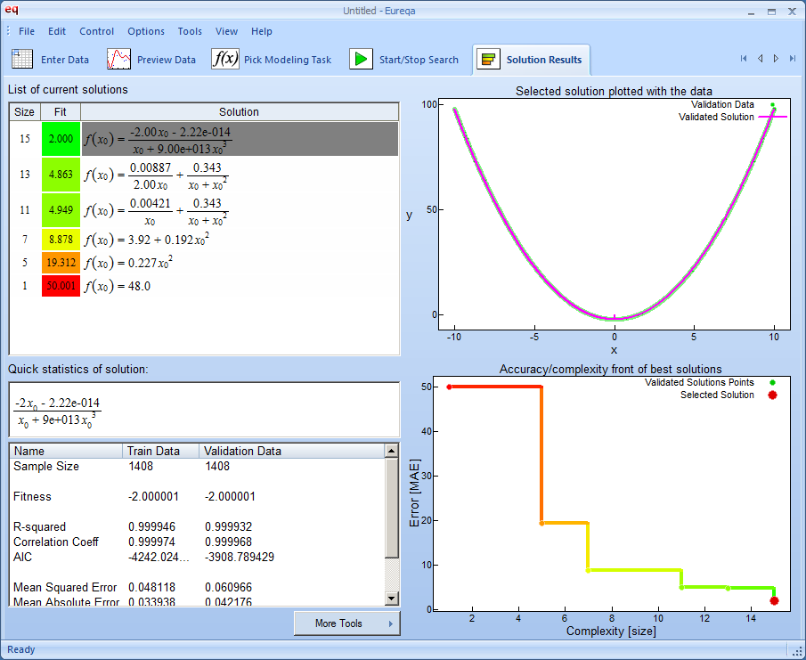
Solved in 81 seconds
And
Solved Reliably:
50 trials
50 trials

Slide 8
Nearly Perfect Fitness
The genetic program is trying to take a limit….

Slide 9
Exactly Correct Symbolicly
The solution is symbolicly correct

Slide 10
New Solution Found with Genetic Programming
f(f(x)) = x² – 2

Slide 11
Human Competitive:
Long-developed and infamous problem in physics and mathematics
Has required deep human insight into mathematics to solve special cases
No other general method exists

Slide 12
Human Competitive:
Long-developed and infamous problem in physics and mathematics
Has required deep human insight into mathematics to solve special cases
No other general method exists
The Best Entry:
Entirely new solution found via GP
Fastest this problem has ever been solved
Potential impact in many fields, where such problems have never been solved before

Slide 13
Conclusions
Use GP to Solve Iterated Functions
f(f(x))

